Slide 1

Classifying Tripadvisor Hotel Reviews
Dai YU

Slide 2
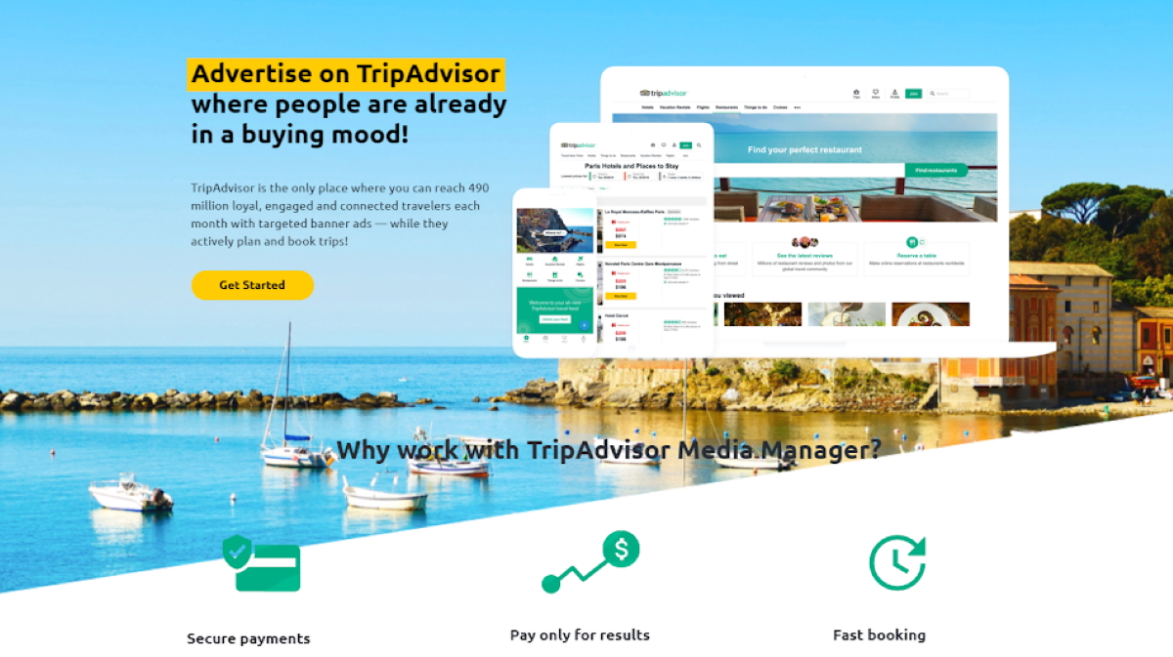
Problem Statement
The H hotel's business development department wants to list the hotel on the TripAdvisor website. The survey result shows 96% of TripAdvisor users consider review rating necessary when planning trips and booking hotels. With online reviews rating having such a strong influence on consumers, the Business Development team tasked the data analyzing unit to develop a model to predict possible H hotel review ratings on TripAdvisor after the listing based on their current customers' feedback Book.com or other platforms. It will reinforce the value of successful online reputation management for hotels and the resulting positive impact on revenue.

Slide 3
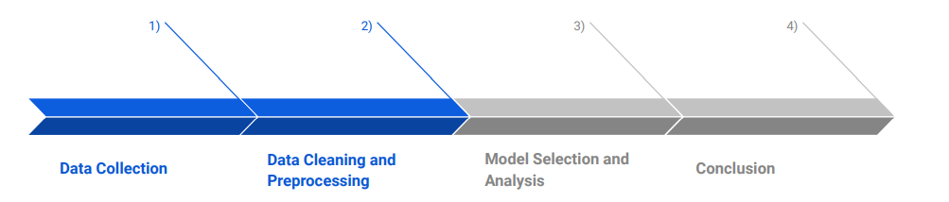
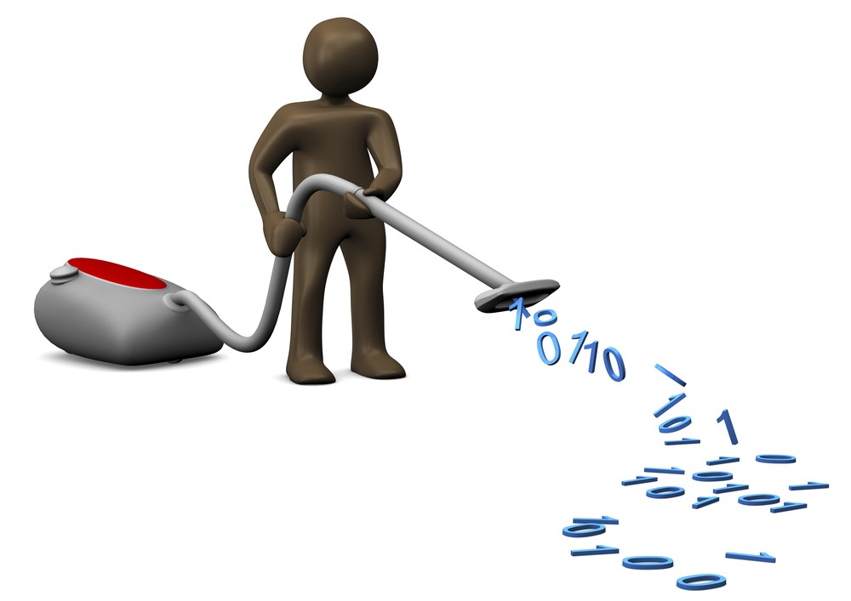




Methodology
Retrieve the TripAdvisor data from Website
Cleaned and prepared the data for modelling.
Selected best performing model based on highest accuracy score.
Conclude our findings and Recommendations to improve our model.

Slide 4
Data Collection and Cleaning
-TripAdvisor dataset download from the [website](http://times.cs.uiuc.edu/~wang296/Data/).
-It contains 12,773 JSON files; each JSON file contains the reviews and the ratings from different aspects.
-Removed the duplicate values
-Replaced outliers with the reasonable value
-Convert origin data to appropriate data type and format for further process
Features | Type | Description
feature | string | customer review combine review title and content
service | float | rating 1 to 5 , 0: no rating for this aspect
cleanliness | float | rating 1 to 5 , 0: no rating for this aspect
overall | float | rating 1 to 5 , 0: no rating for this aspect
value | float | rating 1 to 5 , 0: no rating for this aspect
sleep_quality | float | rating 1 to 5 , 0: no rating for this aspect
room | float | rating 1 to 5 , 0: no rating for this aspect
location | float | rating 1 to 5 , 0: no rating for this aspect
internet_service | float | rating 1 to 5 , 0: no rating for this aspect
business_service | float | rating 1 to 5 , 0: no rating for this aspect
front_desk | float | rating 1 to 5 , 0: no rating for this aspect

Slide 5
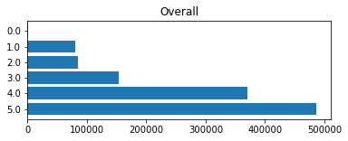
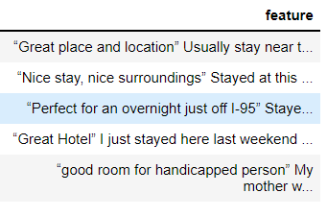
Data Exploration
1. problem: Unbalance Data set for all Classes 2. problem: unwanted information in review text
solution: Balance the dataset solution: only extract the adjective words

Slide 6
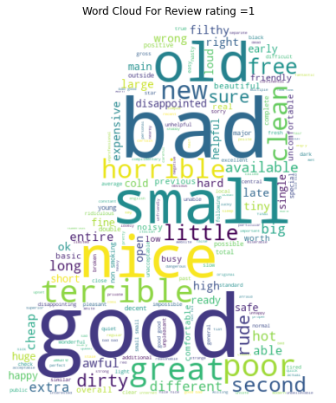
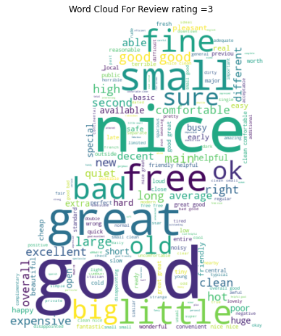
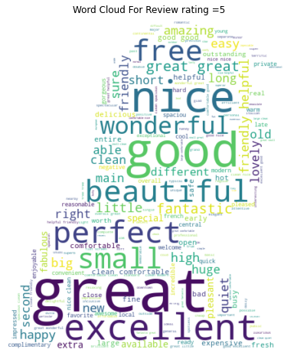
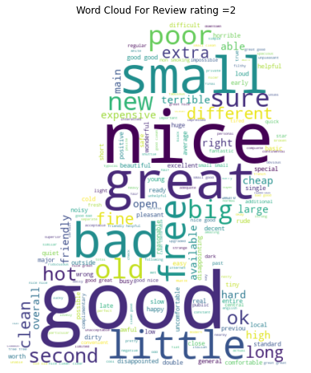
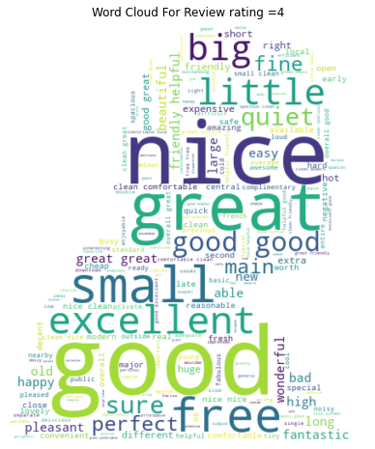
Text Mining-Word Cloud

Slide 7
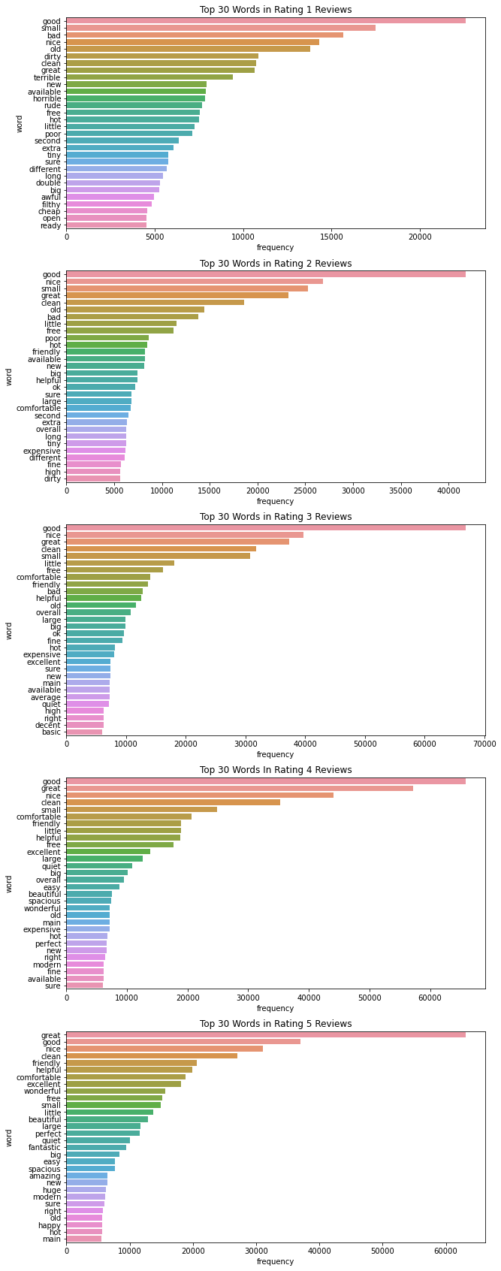
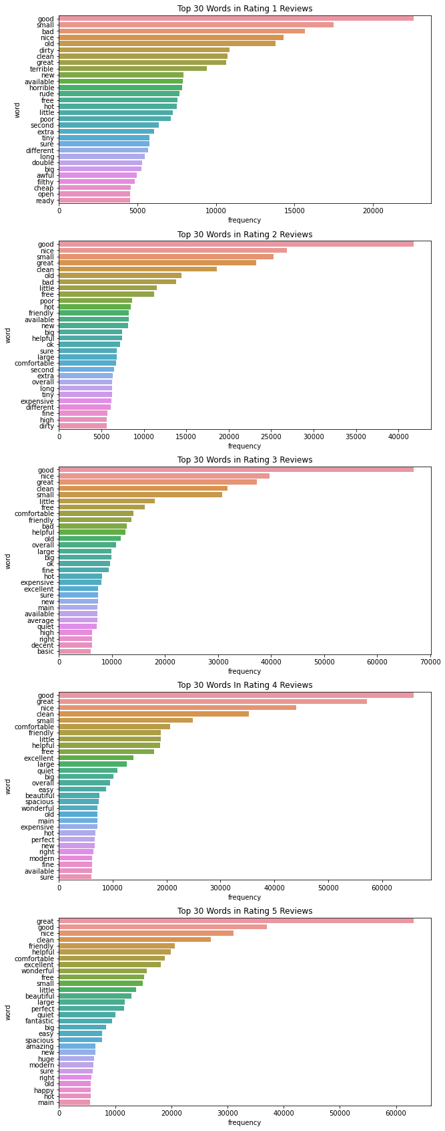
Text Mining-Bar Chart

Slide 8
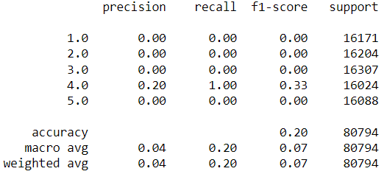
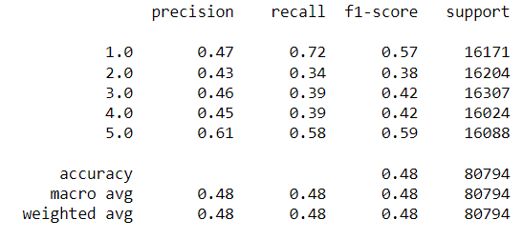
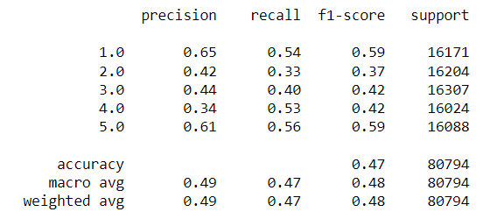
Modelling and Evaluation
Multinomial NB
Dummy Classifier
Logistic Regression

Slide 9
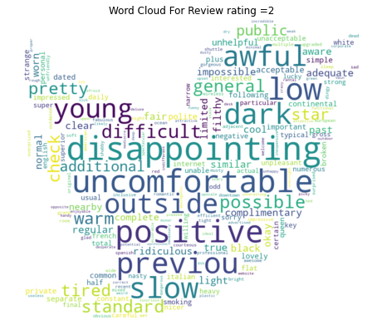
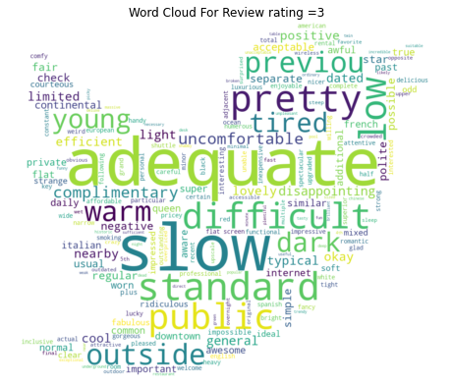
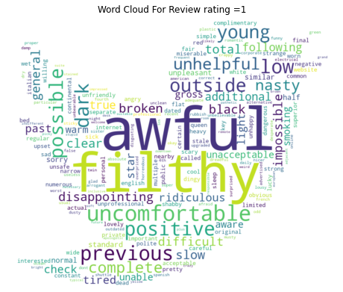
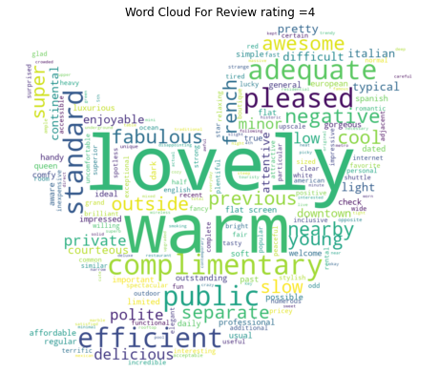
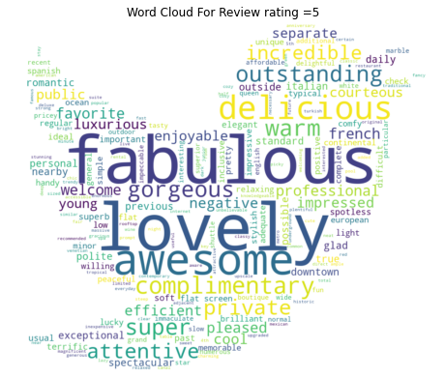
Text Mining-Word Cloud without Top 100 common words

Slide 10
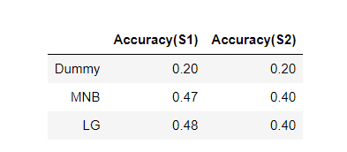
Modelling and Evaluation-Without Top 100 common words

Slide 11
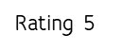
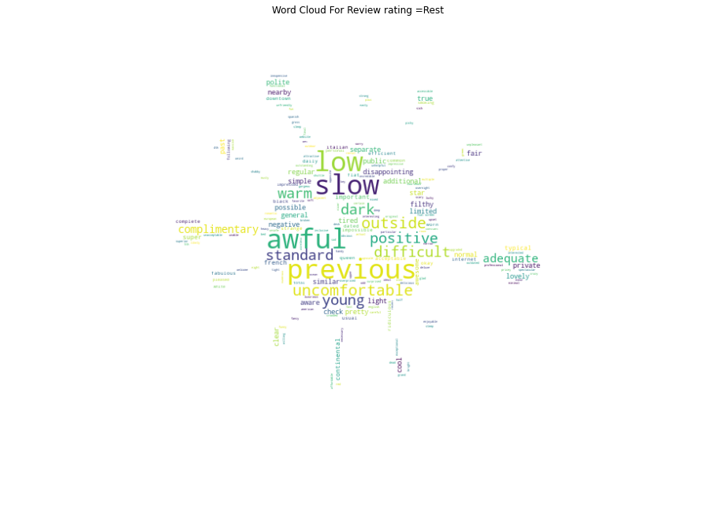
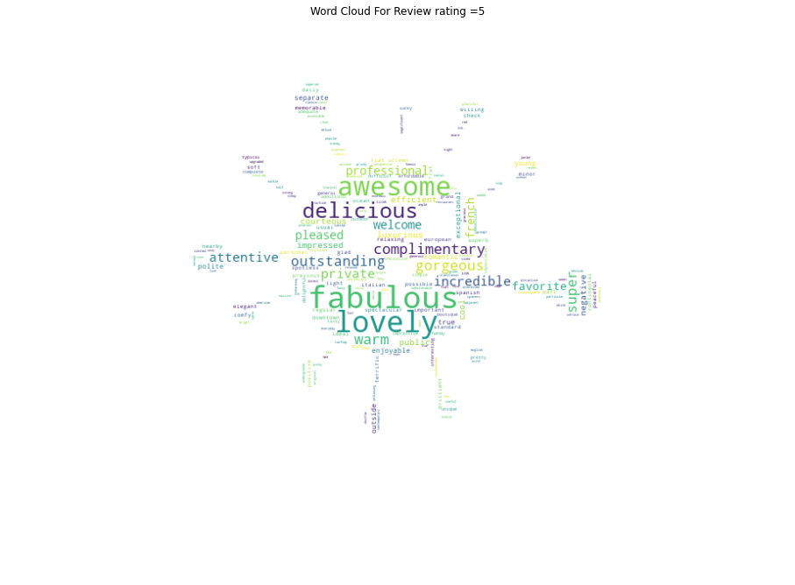
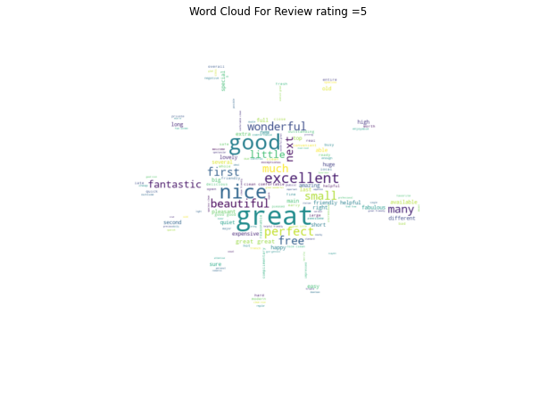
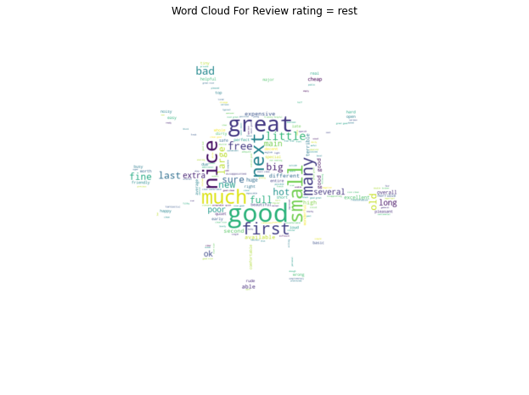
Text Mining-Binary Classification
We will group one-star to four-star ratings together as one class. We will predict a five-star rating or rest instead of all individual rating classes. We balanced the dataset by downsize the majority group
Rating 5
Rest
Rest
With top 100 common words
Without top 100 common words

Slide 12
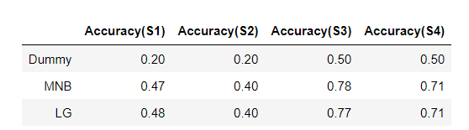
Modelling and Evaluation-Binary Classification

Slide 13
Conclusion
-TripAdvisor is an ideal platform for H Hotel to partner. A reliable Machine learning model to predict the future Rating in the TripAdvisor platform is essential for evaluating the partnership's success.
-The Documents collected from uiuc.edu are preprocessed by removing the stopwords and punctuations and returning to based form words. We found the documents contained unnecessary information for modeling during the Data Exploring Analysis. We decided only to keep the adjective phrases for modeling. Considering the complexity of this project's features, we use the Multinomial NB and Logistic Regression modeling method to predict the outcomes.
-The result shows Multi-class classification did not perform as well as binary classification. Multi-class has very low accuracy in predicting a 1 to 5-star Rating and converting to Binary classification, a significate improvement for the accuracy. Features reduction will result in accuracy loss. Multinomial NB shows slightly better accuracy than logistic regression in Binary classification. We may deploy Multinomial NB to predict the possibility of getting a 5-star Rating in Tripadvisor for Hotel H.
-Further, we will continue to explore NLP techniques. We could dive deeper into aspect rating studying, opinion grouping the Text data, or sentimental analysis. Those will help to improve model performance in the future for sure.

